Slide 1
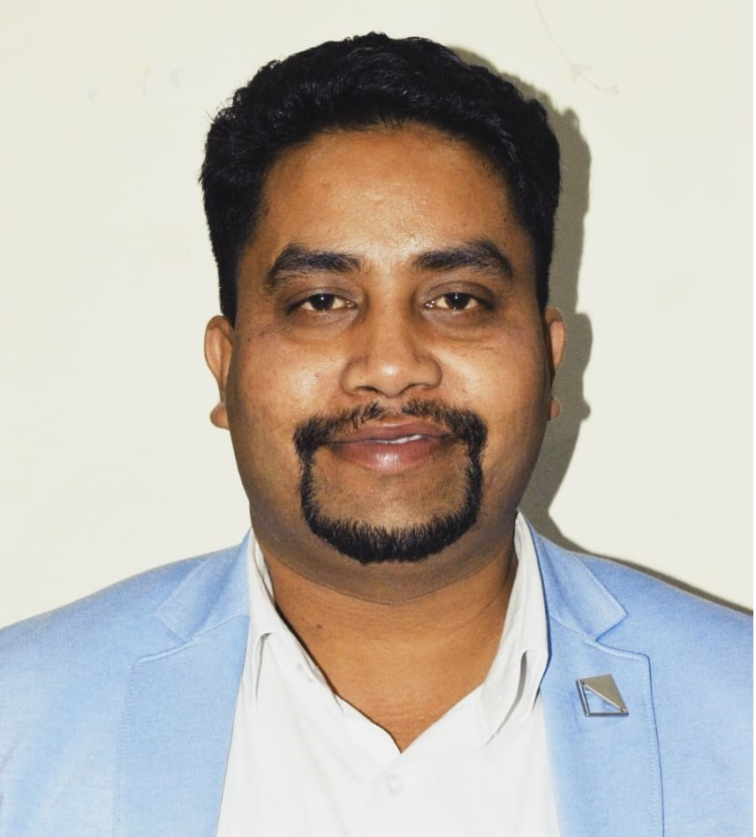
CYBER ENRICH TRAINING PROGRAM | MODULE II
Identify & Access Management Lifecycle
DR.HITESH KUMAR SHARMA
Senior Associate Professor
Technical Instructor & Consultant

Slide 2
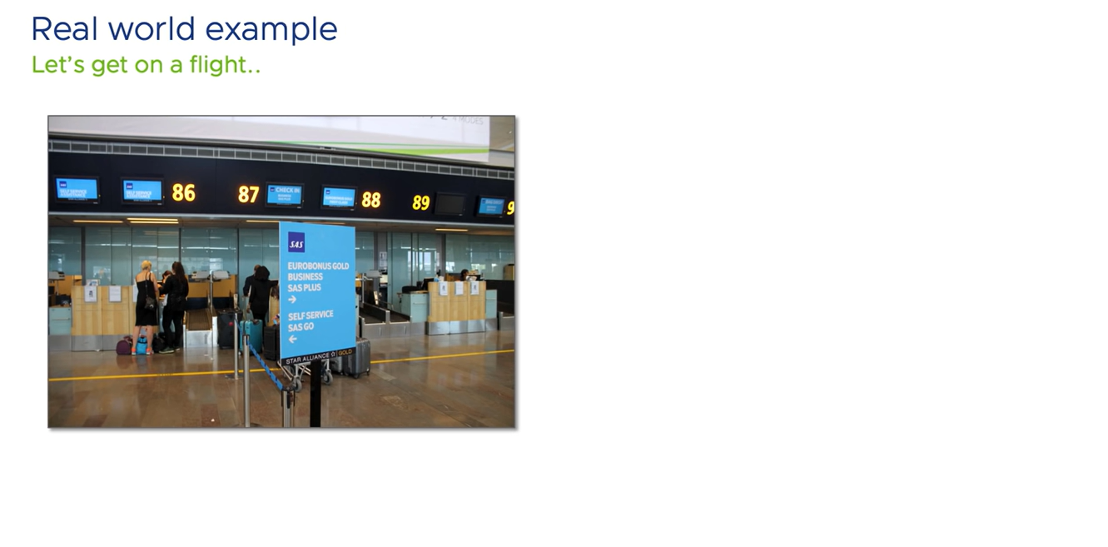

Slide 3
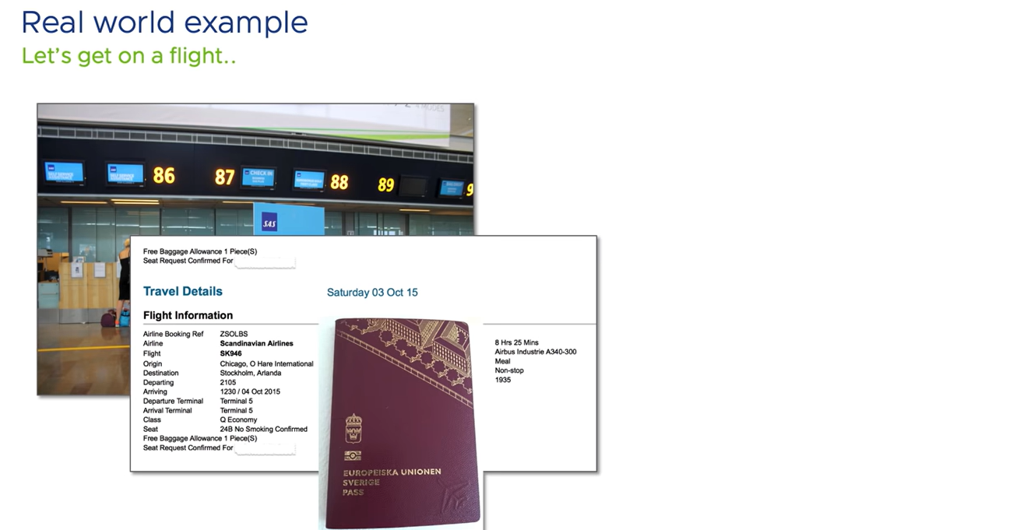

Slide 4
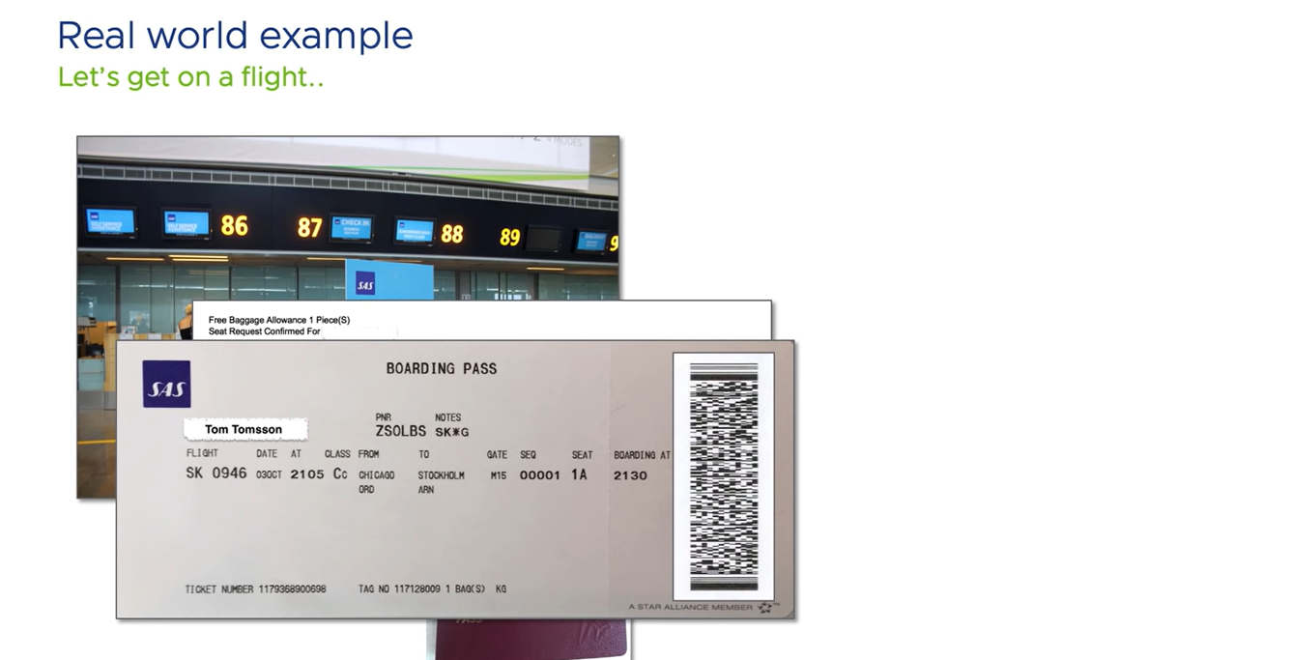

Slide 5
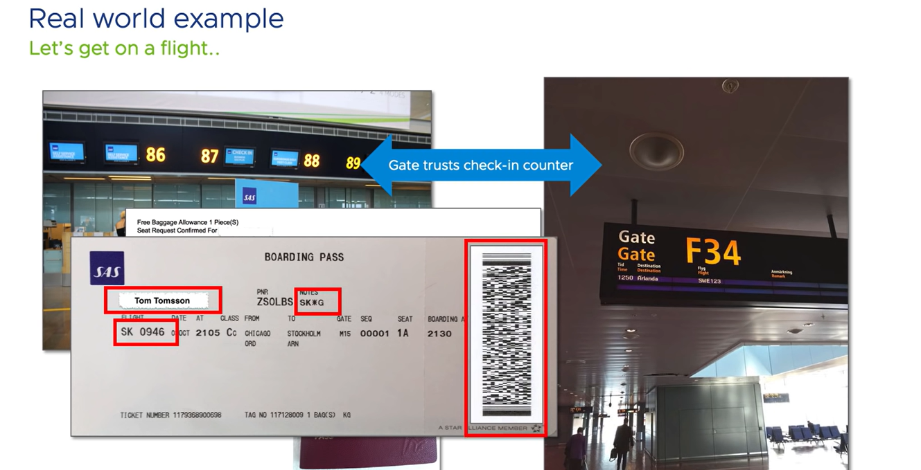

Slide 6
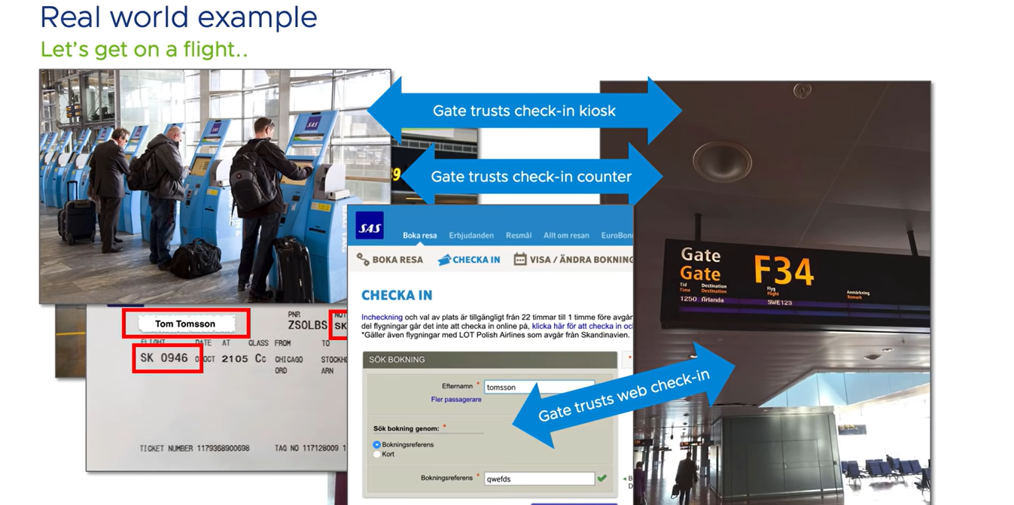

Slide 7
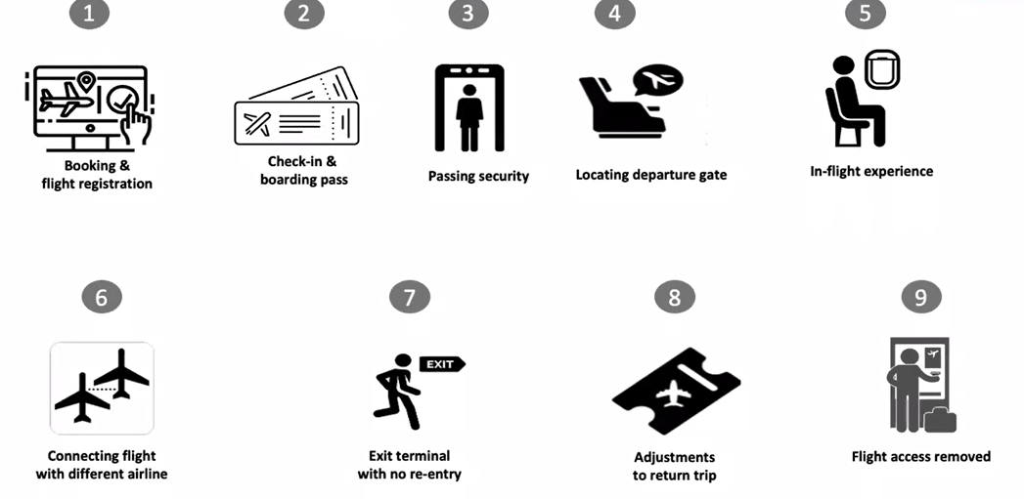

Slide 8
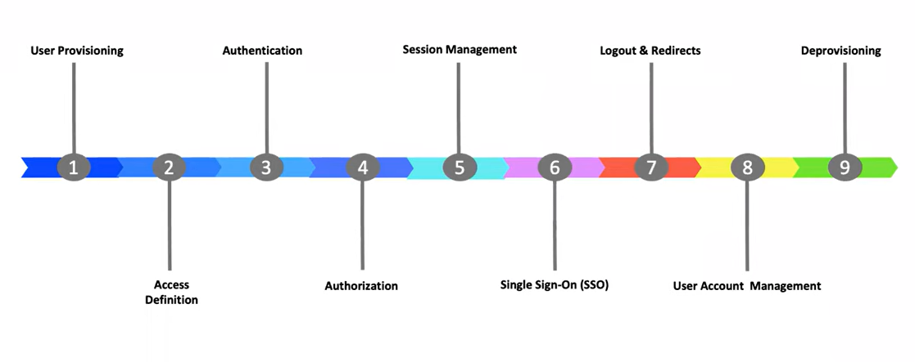
IAM Lifecycle

Slide 9
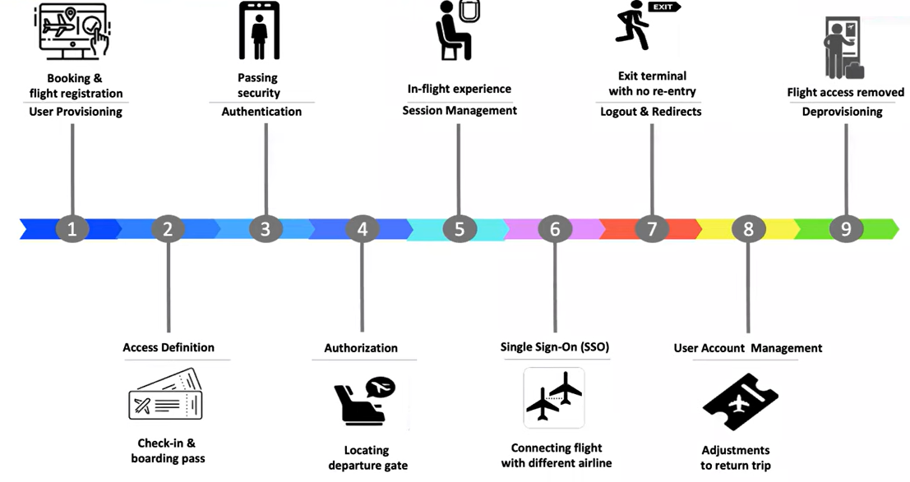

Slide 10
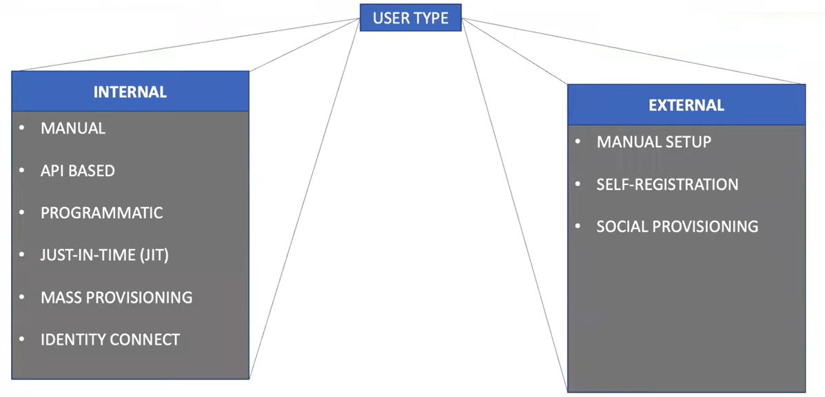
Stage 1: User Provisioning

Slide 11
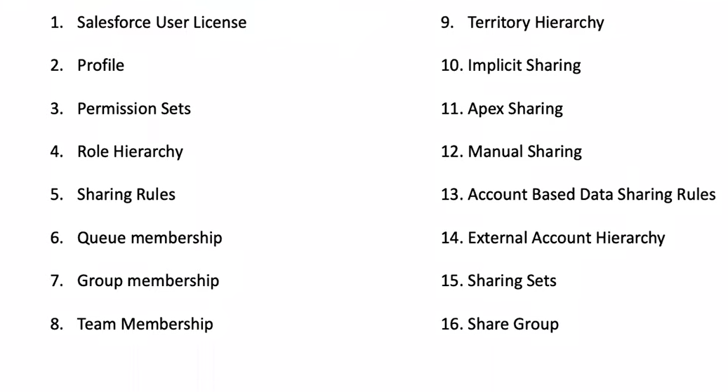
Stage 2: Access Definition

Slide 12
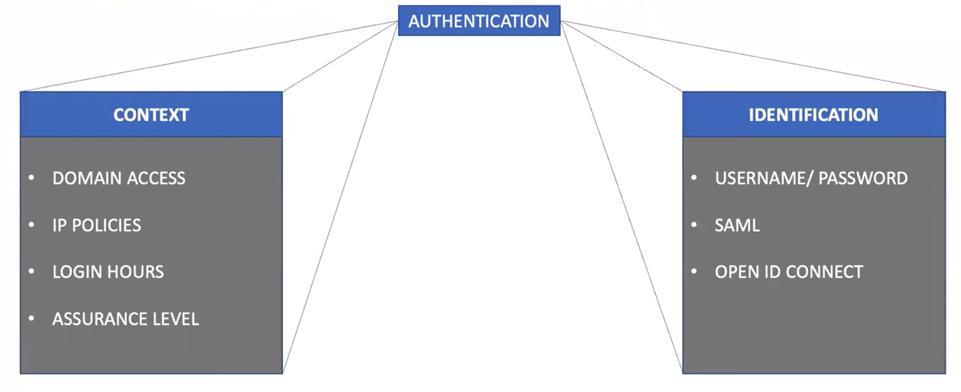
Stage 3: Authentication

Slide 13
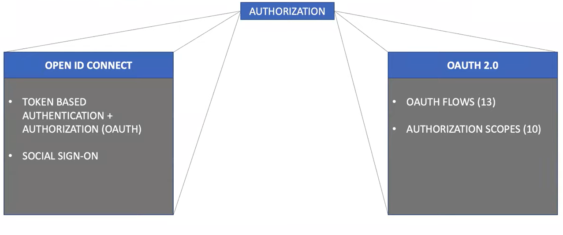
Stage 4: Authorization

Slide 14
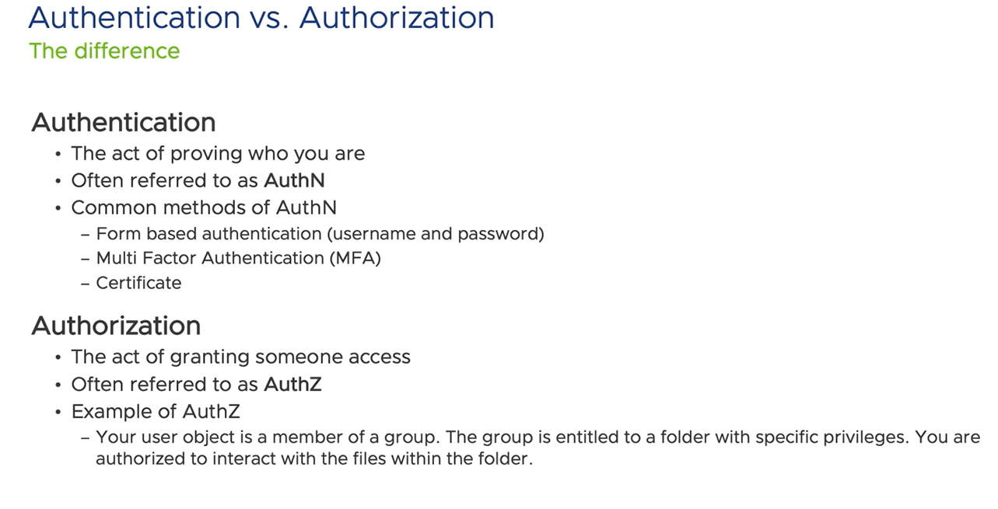

Slide 15
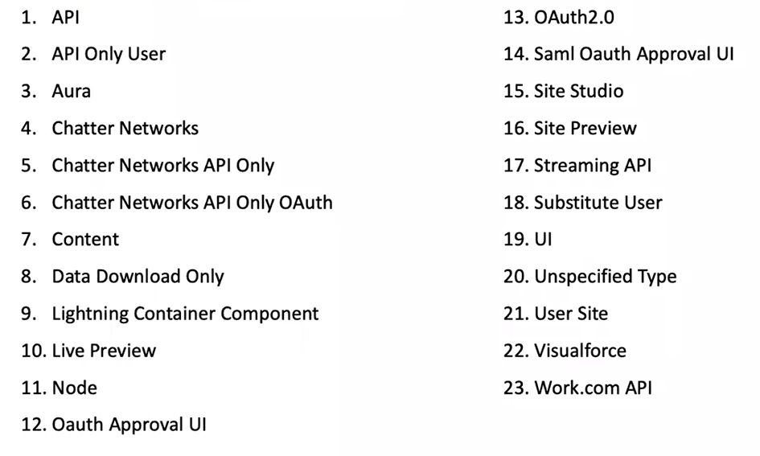
Stage 5: Session Management

Slide 16
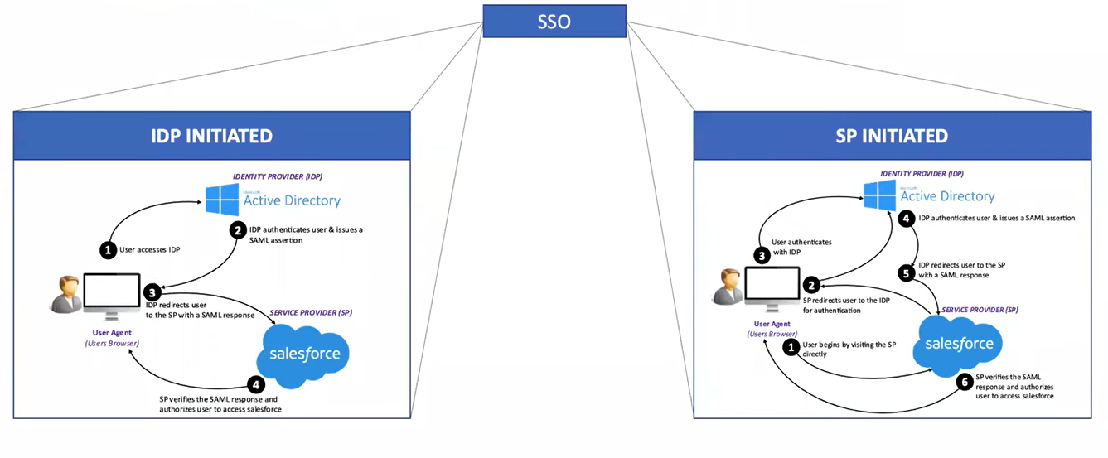
Stage 6: Single Sign On (SSO)

Slide 17
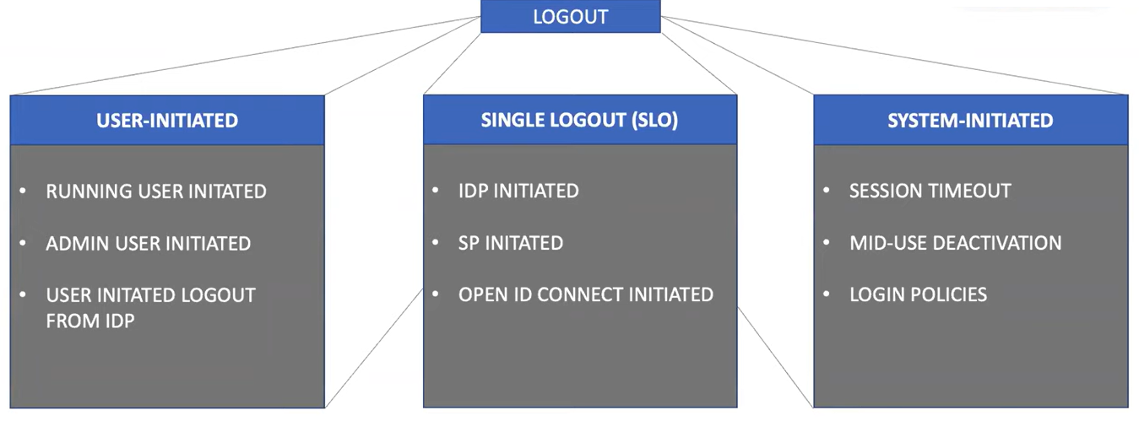
Stage 7: Logout and Redirects

Slide 18
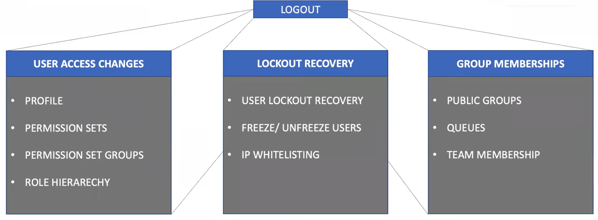
Stage 8: User Account Management
UAM

Slide 19
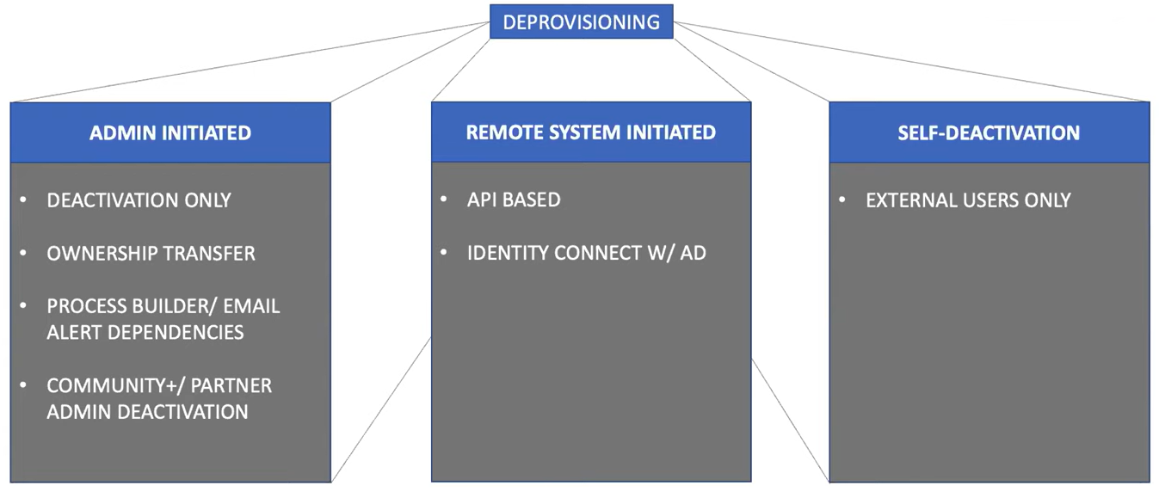
Stage 9: Deprovisioning

Slide 20
